Slide 1
Online Banking System
-By
KEERTHI KUMAR RAVICHANDRAN
JAYABHARATHI SUNDARARAJ
ANVESH RAGI
RASAGNA RAMIREDDY

Slide 2
Introduction
Online Banking System provided is specifically developed for online banking regarding Balance Enquiry, Funds Transfer to another account, View Transactions, View Updates / Alerts, Mini statements.
PROS:
To Avoid cons of Traditional Banking system.
To make people's life easy in managing money like:
1.Viewing Balance.
2.Viewing Transactions made.
3.Make Transfers.
4.Deposit money via Check
5.More safe and also can avoid paper.

Slide 3
Requirements
1. Create Account
2. Login
3. View Balance
4. Make Transfers
5. View Transactions
6. Account Alerts/ Updates
7. Manage Account
8. LogOut

Slide 4
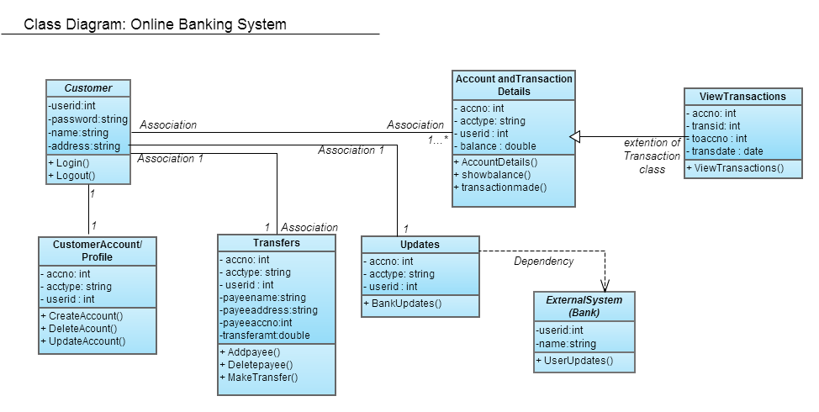
Class Diagram
The below class diagram shows that the customer can have more than one account and thus relationship goes to one to many relationship with Account and Transaction Details. The Updates/lert functions always depends on the updates pushed from External System(Bank).

Slide 5
Overall Use Case Modeling: Online Banking System
Based on the functional requirements, eight use cases have been identified.
Primary actors are Customer and Bank Database.
Every requirement needs customer to be logged in and logged out except the "Create Account" functionality.

Slide 6
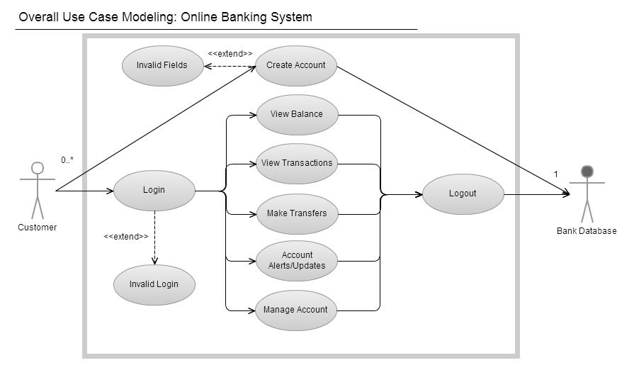
Overall Use Case Modeling

Slide 7
Nonfunctional Requirements
Performance
Safety
Reliability
Security
Maintainability
Portability

Slide 8
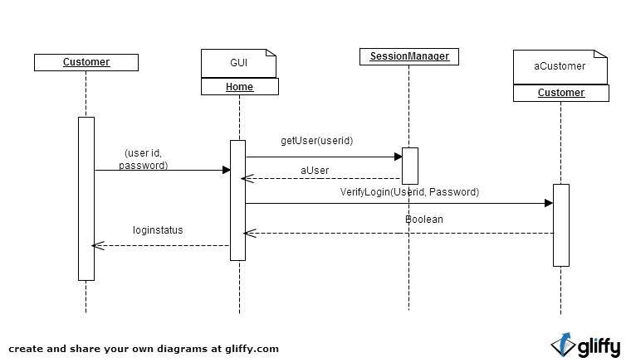
Sequence Diagram

Slide 9
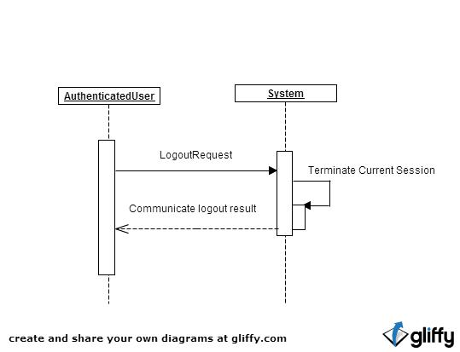

Slide 10
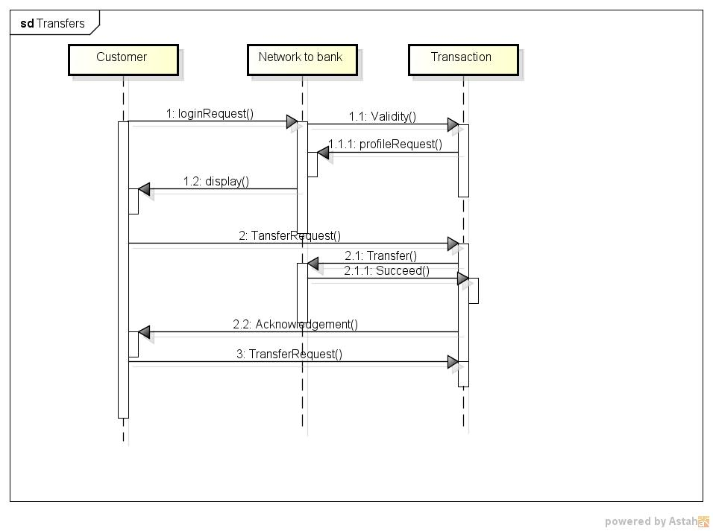

Slide 11
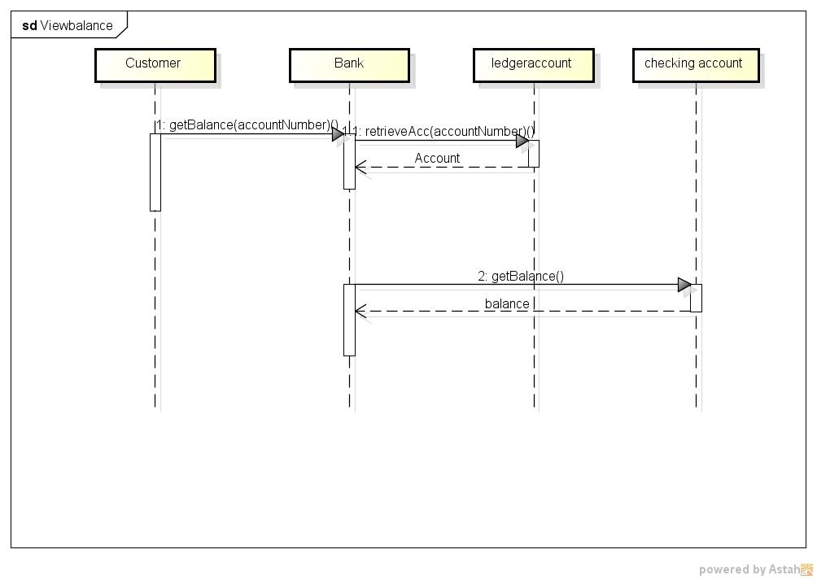

Slide 12
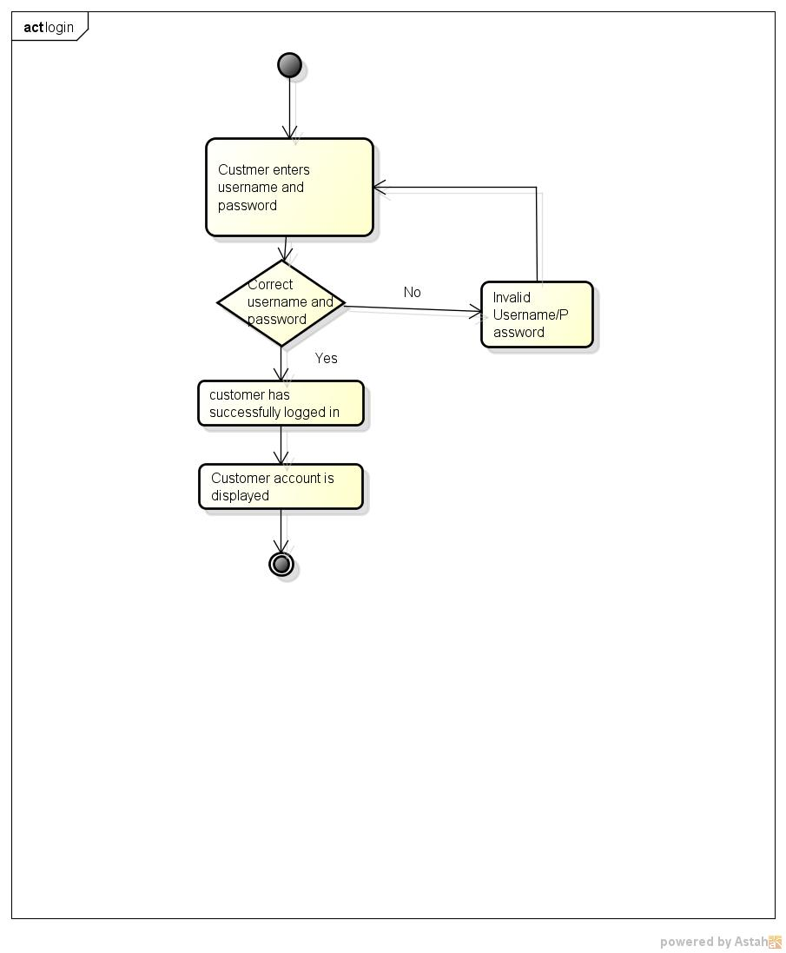
Activity Diagrams

Slide 13
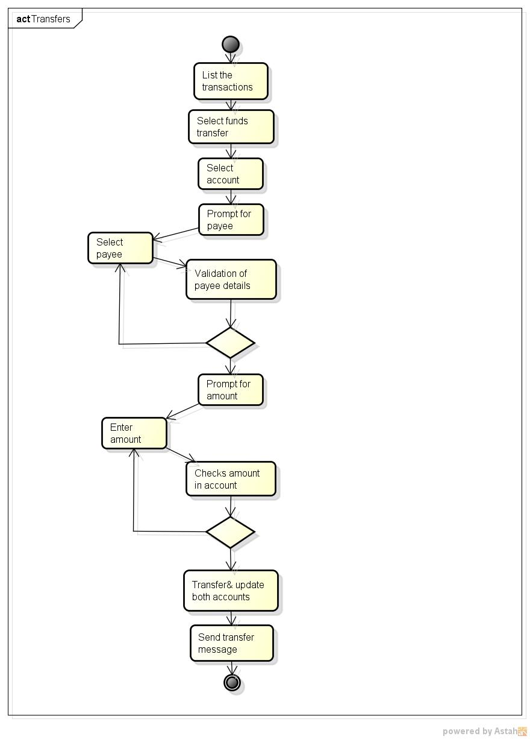

Slide 14
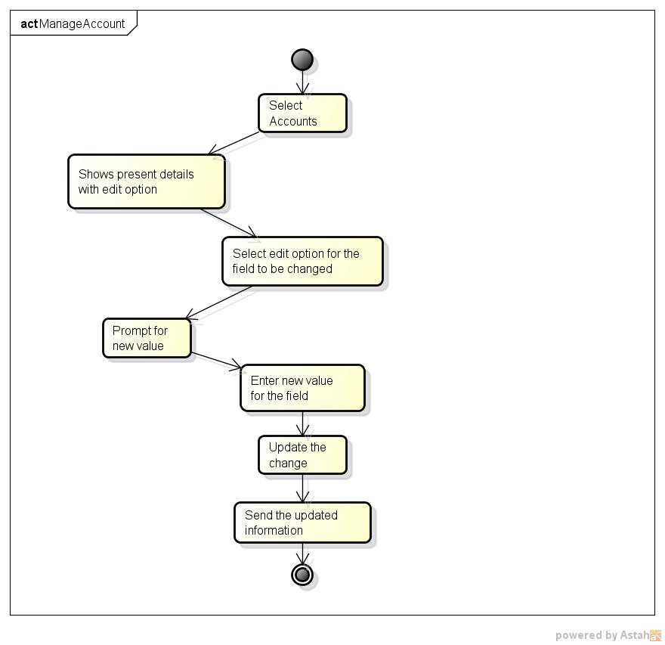

Slide 15
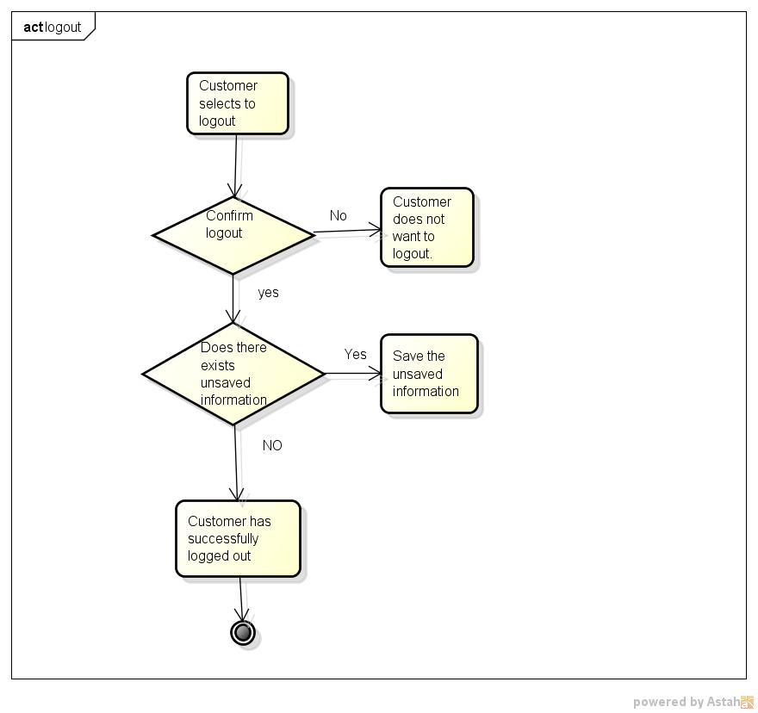

Slide 16
THANK YOU

